Slide 1


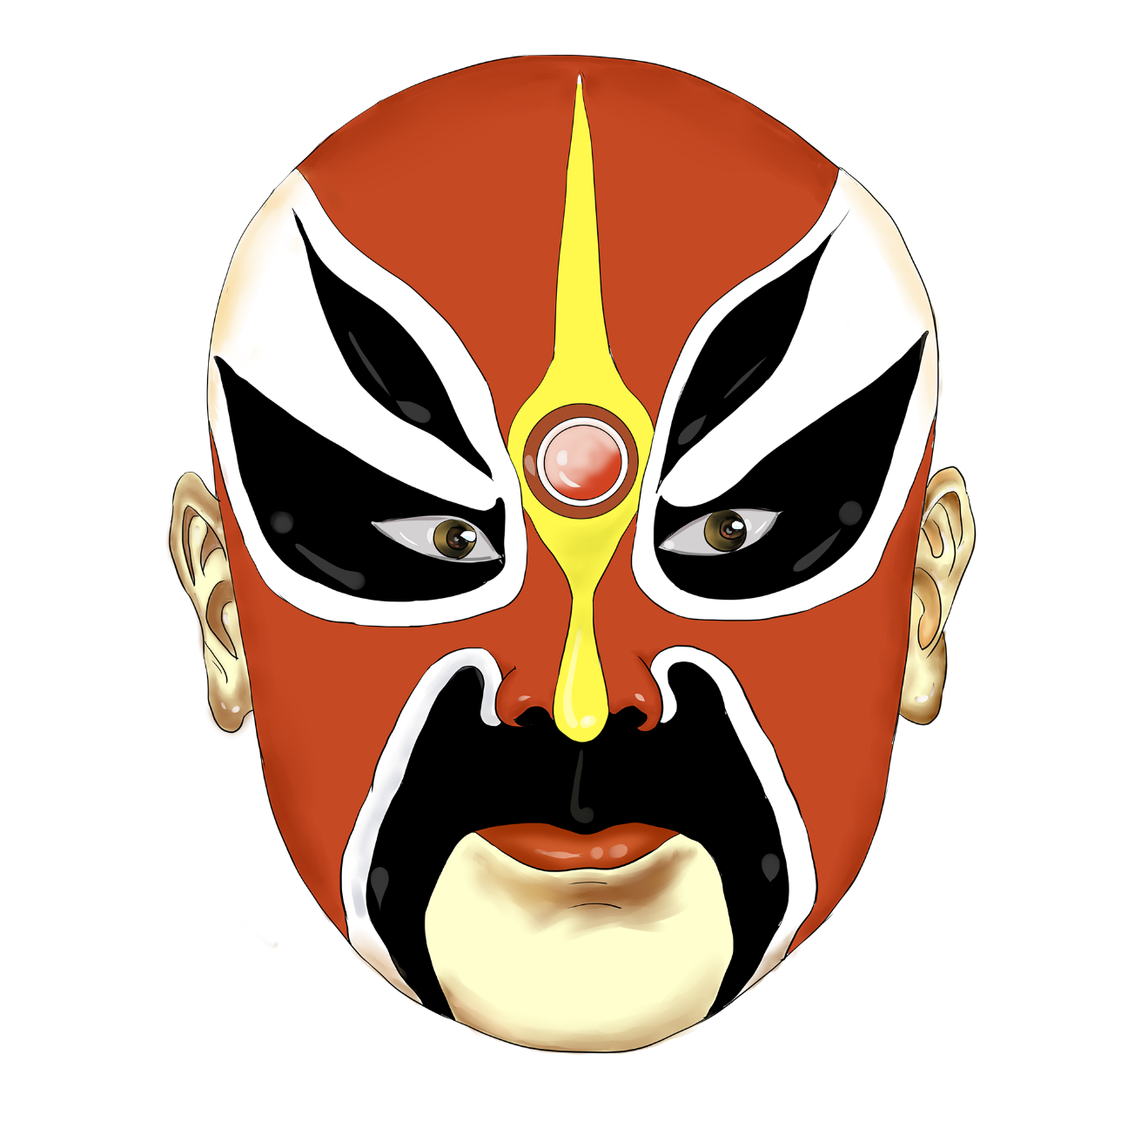
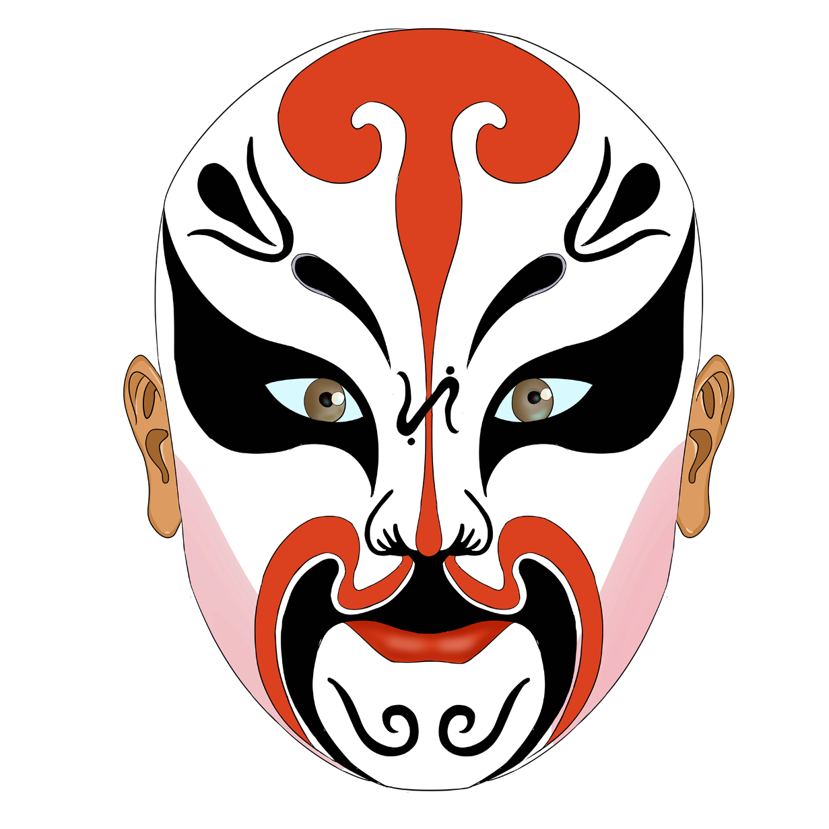






JingjuMel: the melodic patterns in different performance dimensions: role type, Shengqiang, banshi
Mario Ortega García, Qin Liu
中华文化

Slide 2




Introduction to Jingju
1
壹
Origin
贰
Expression form
叁
Role type
肆
Shengqiang
伍
banshi

Slide 3
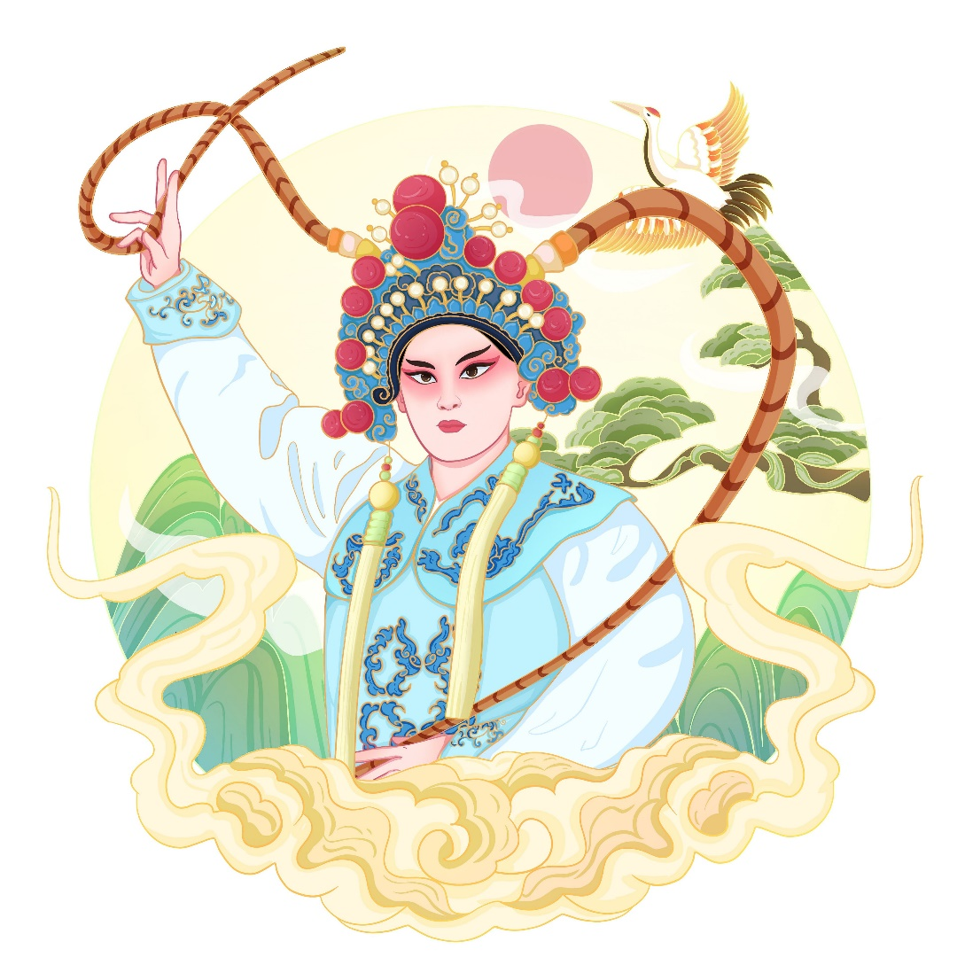
壹
Origin
During the reign of Emperor Qianlong (BC 1736－1796) of the Qing Dynasty, Hui Ban, a group of folk artists from Anhui Province, came to Beijing to perform, and soon Hubei's Han Opera group also came to Beijing to perform, and they merged with each other in Beijing, and drew on the strengths of some other regional operas, such as the Kunqu Opera, to form today's Jingju.

Slide 4

贰
Expression Form
Four major performance techniques: the four basic skills
Singing（Shengqiang）
Speaking
Acting
Fighting

Slide 5

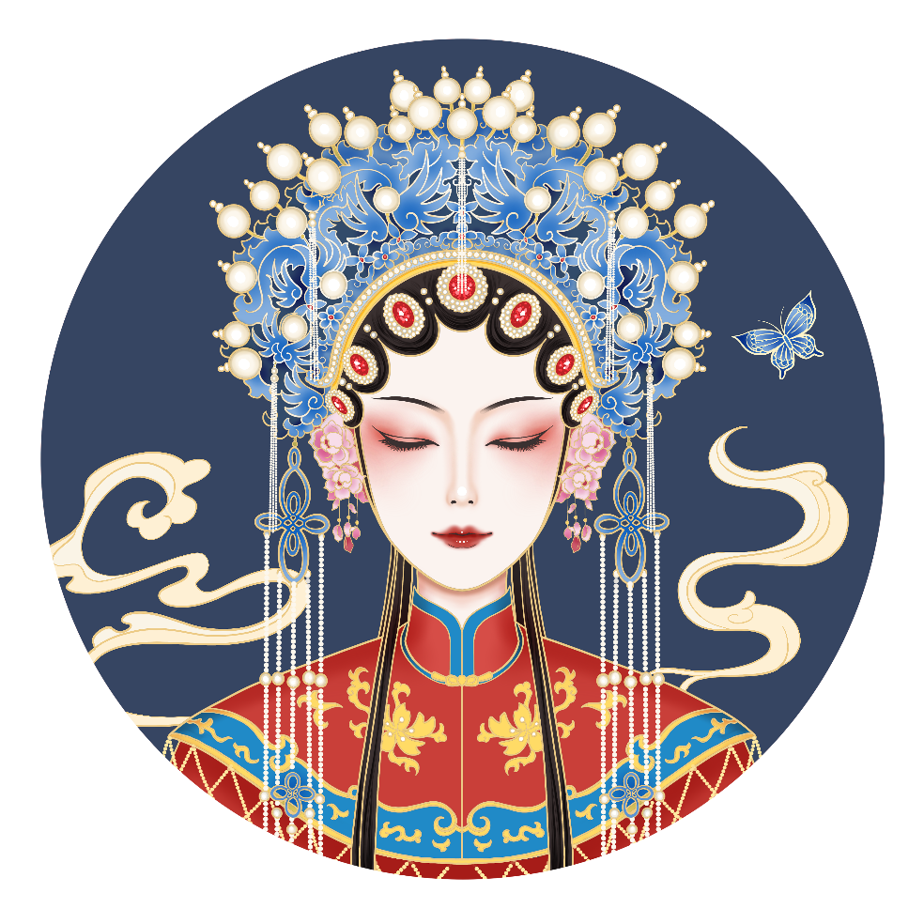
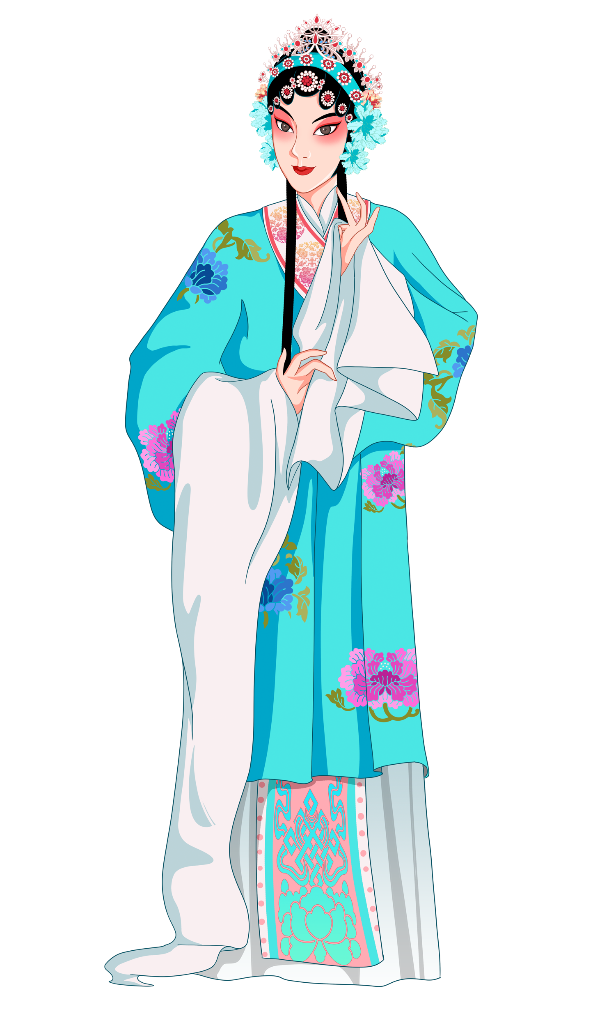
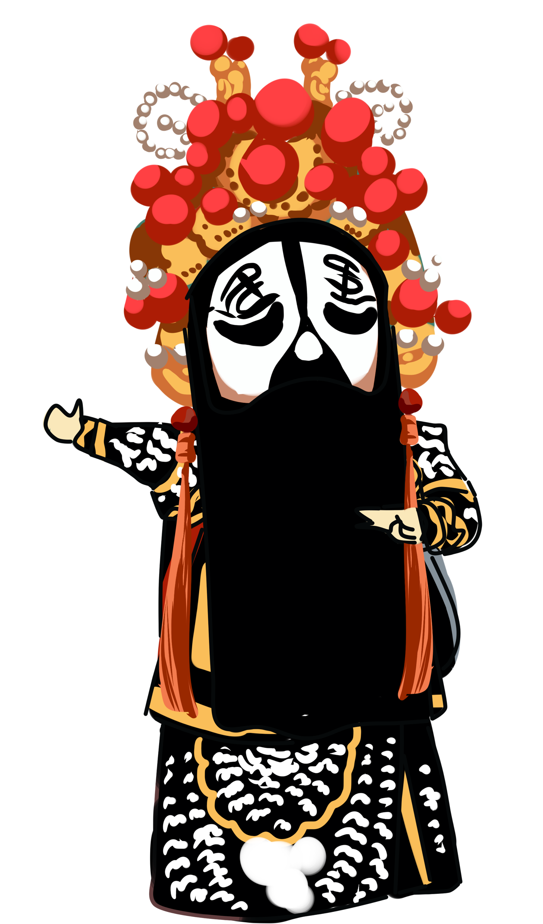
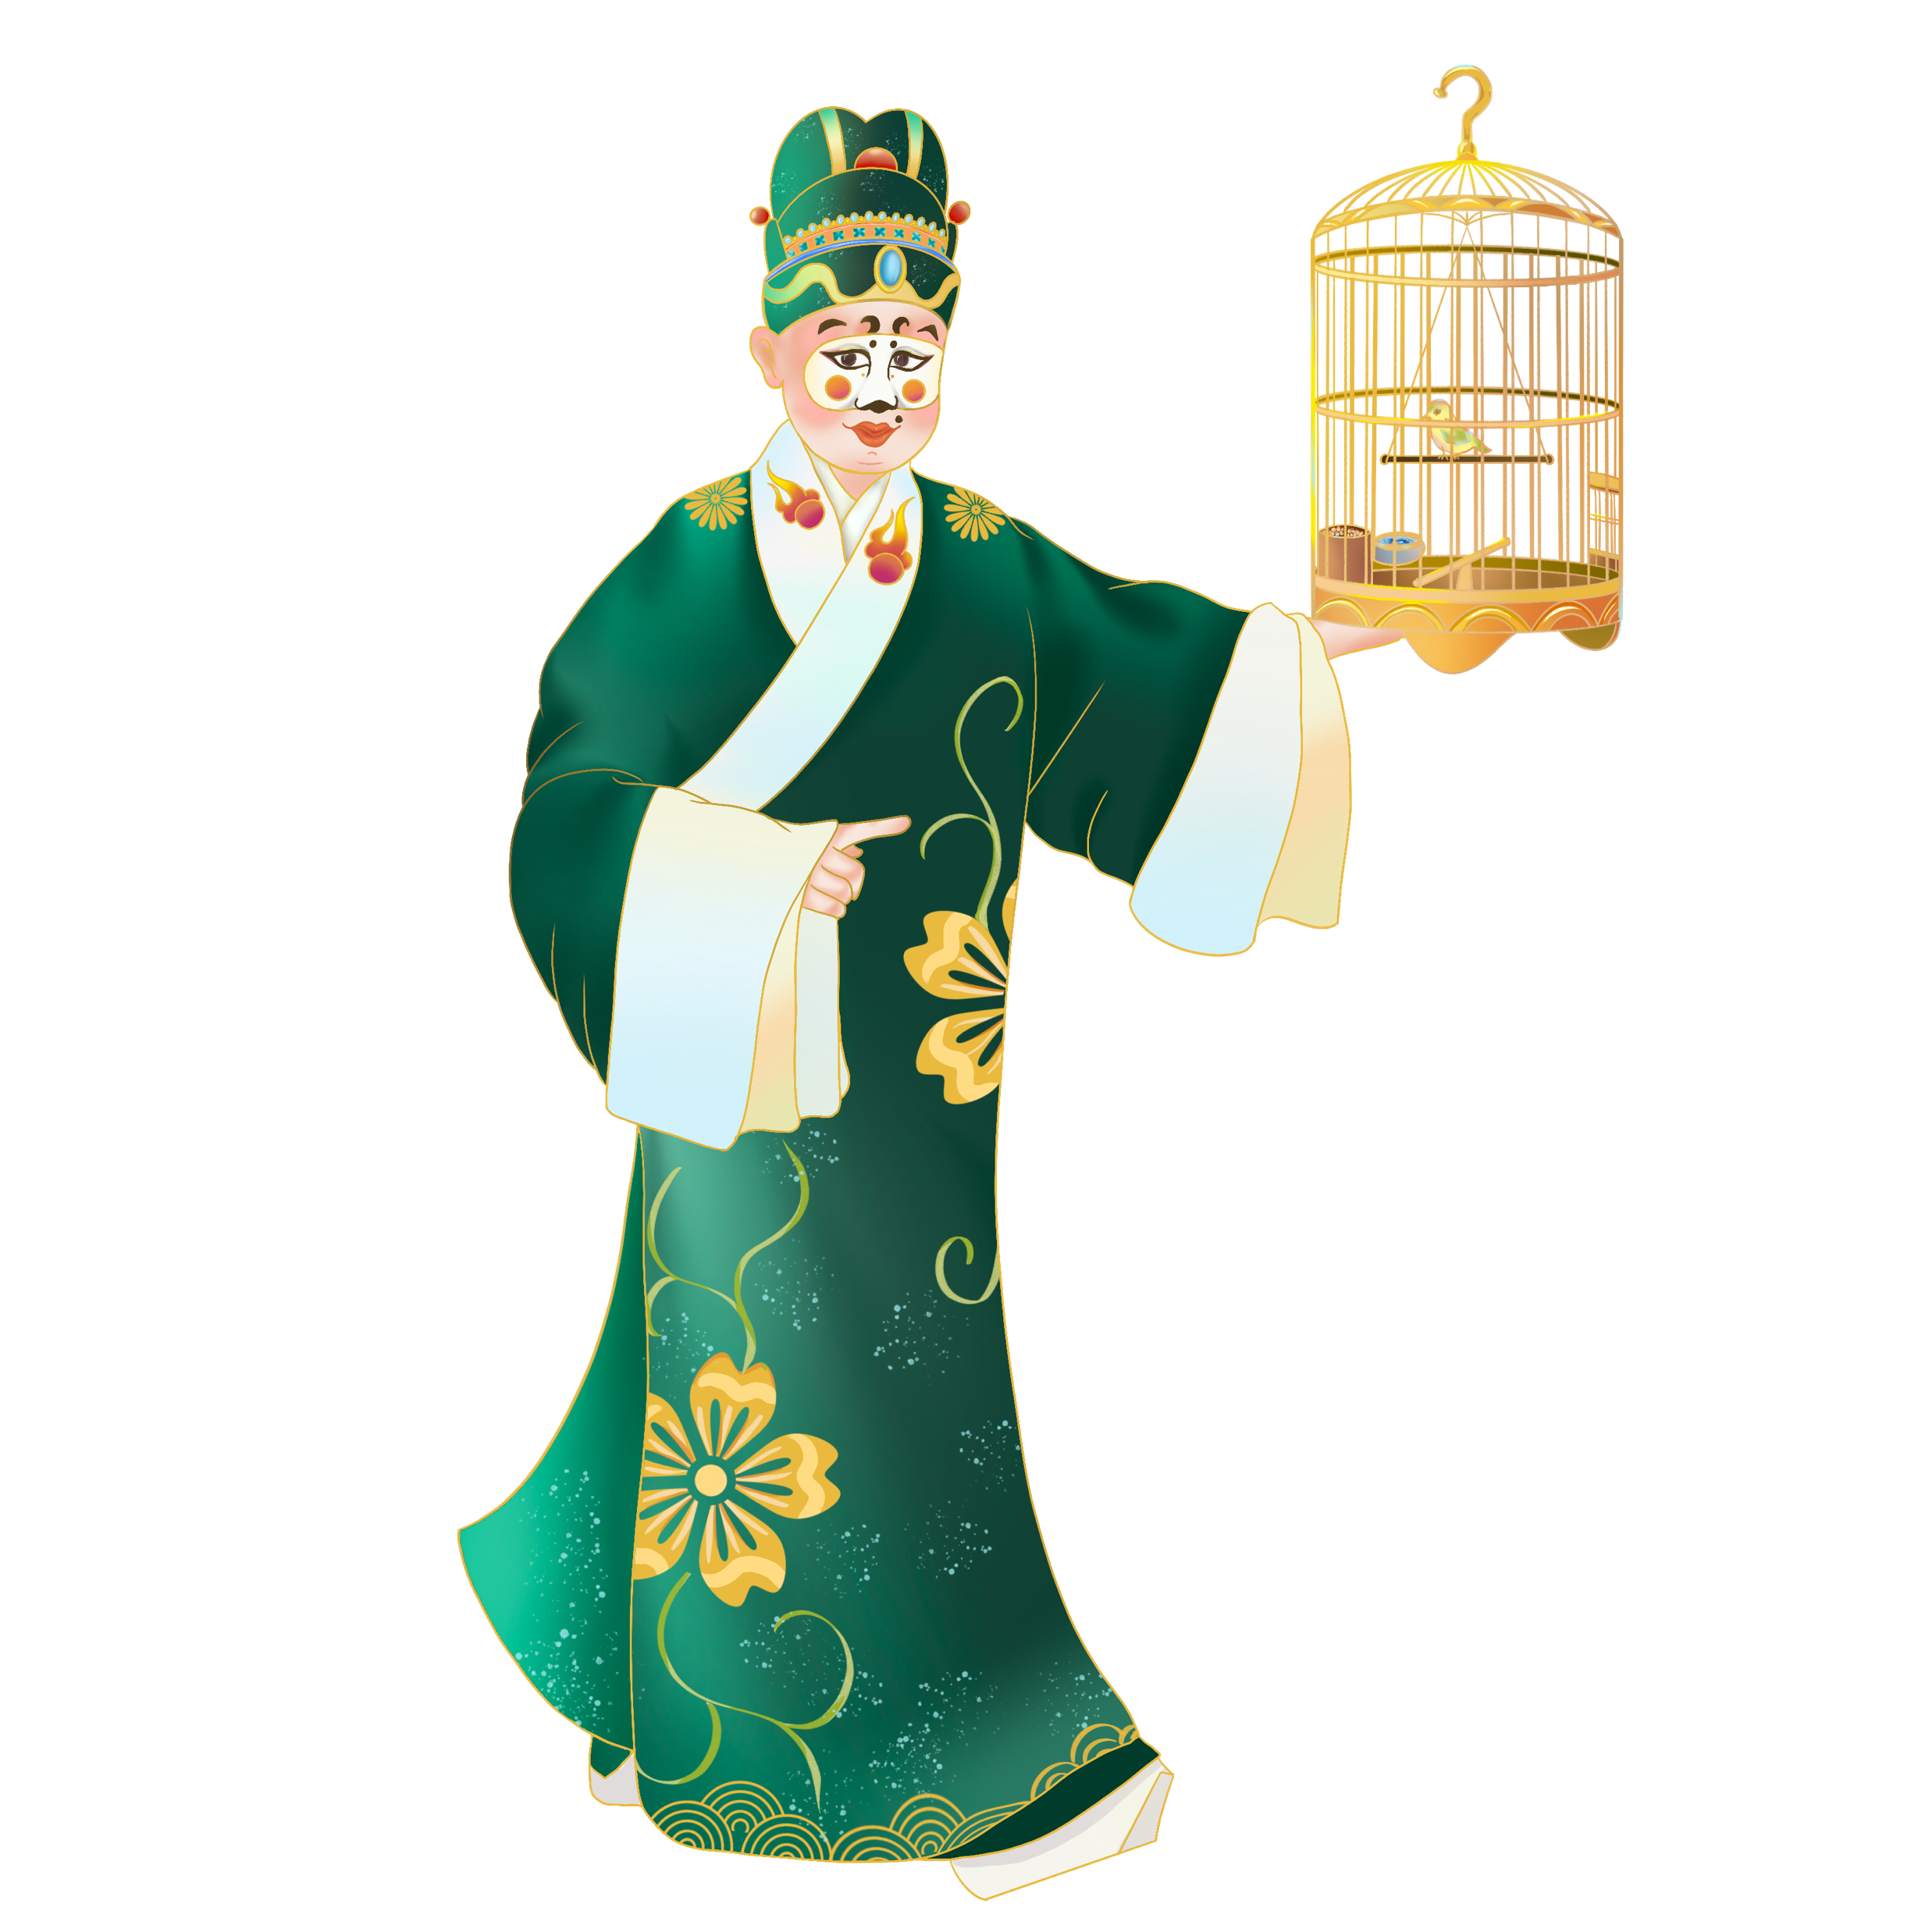
叁
Role Type
Shēng
General men's roles
Dàn
General men's roles
Jìng
Men of unusual appearance or character
Chǒu
A funny or evil man, like ‘clown’
Notes:
There are 4 main types, and each role has a variety of subdivisions

Slide 6
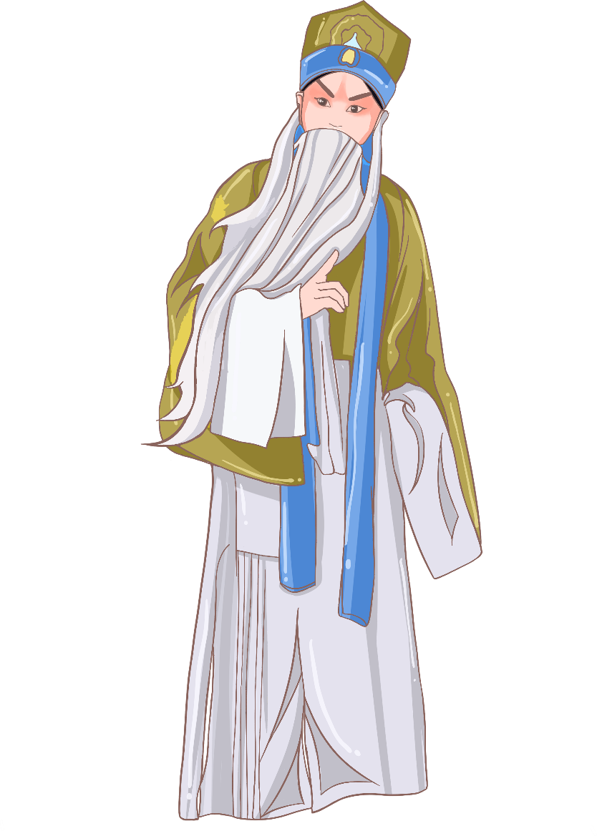
肆
Shengqiang - Vocal Styles
*Erhuang
*Xipi
Nanbangzi
Sipingdiao
Notes:
Erhuang: is a vocal style of rhythmic relief, smooth melody, singing more heavy, thick, steady voice. Suitable for the expression of gloomy, solemn, sad and impassioned emotions.
Xipi: is a vocal style of compact rhythm, large melodic fluctuations of the voice. The voice is smooth, light, bright and lively.
suitable for expressing cheerfulness, perseverance and indignation.

Slide 7
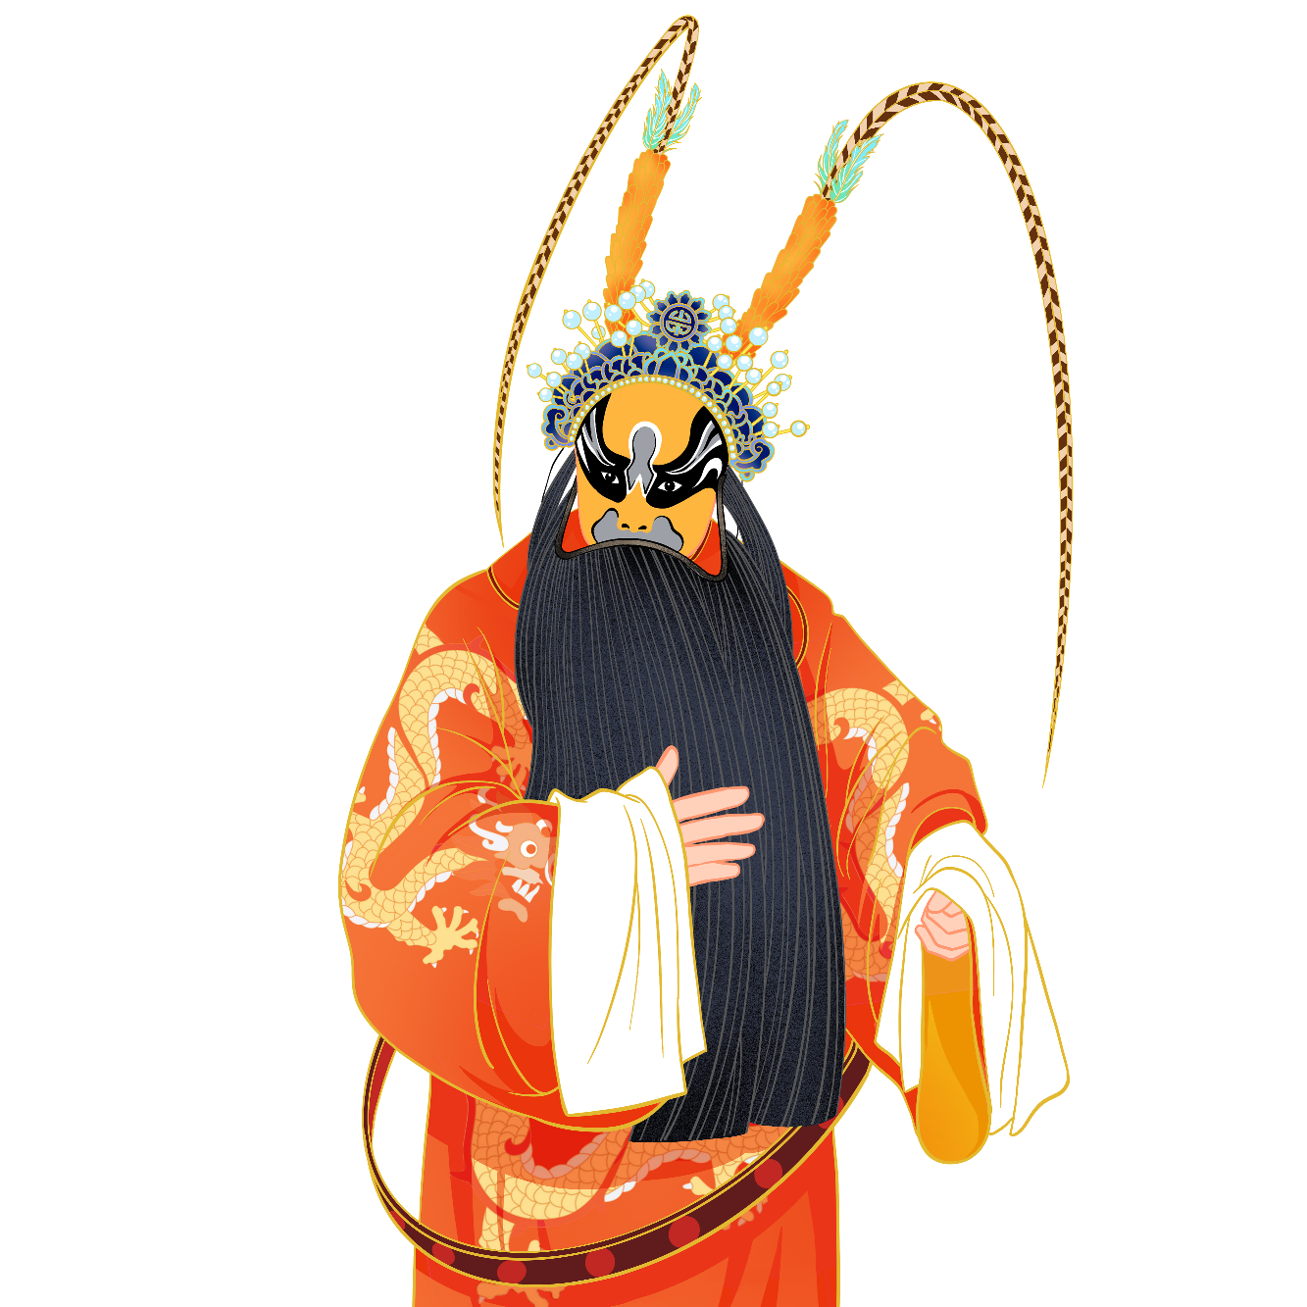
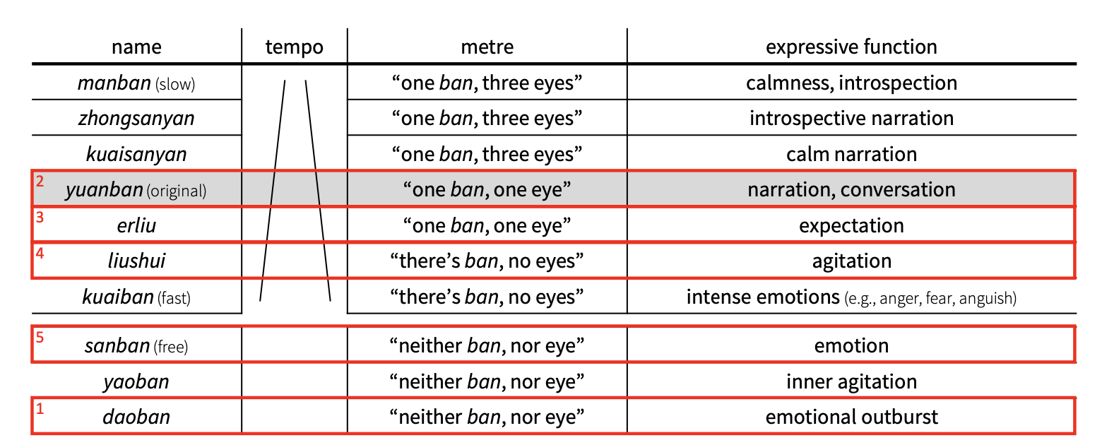
伍
banshi-rhythmic pattern
* bǎn: beat/downbeat, shì: style
* eye: upbeat

Slide 8
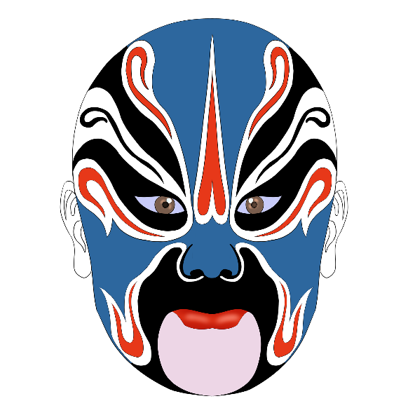
2
Research Question
In Jingju music, what are the most prevalent melodic patterns associated with different “shengqiang”, “banshi”, and role types?

Slide 9
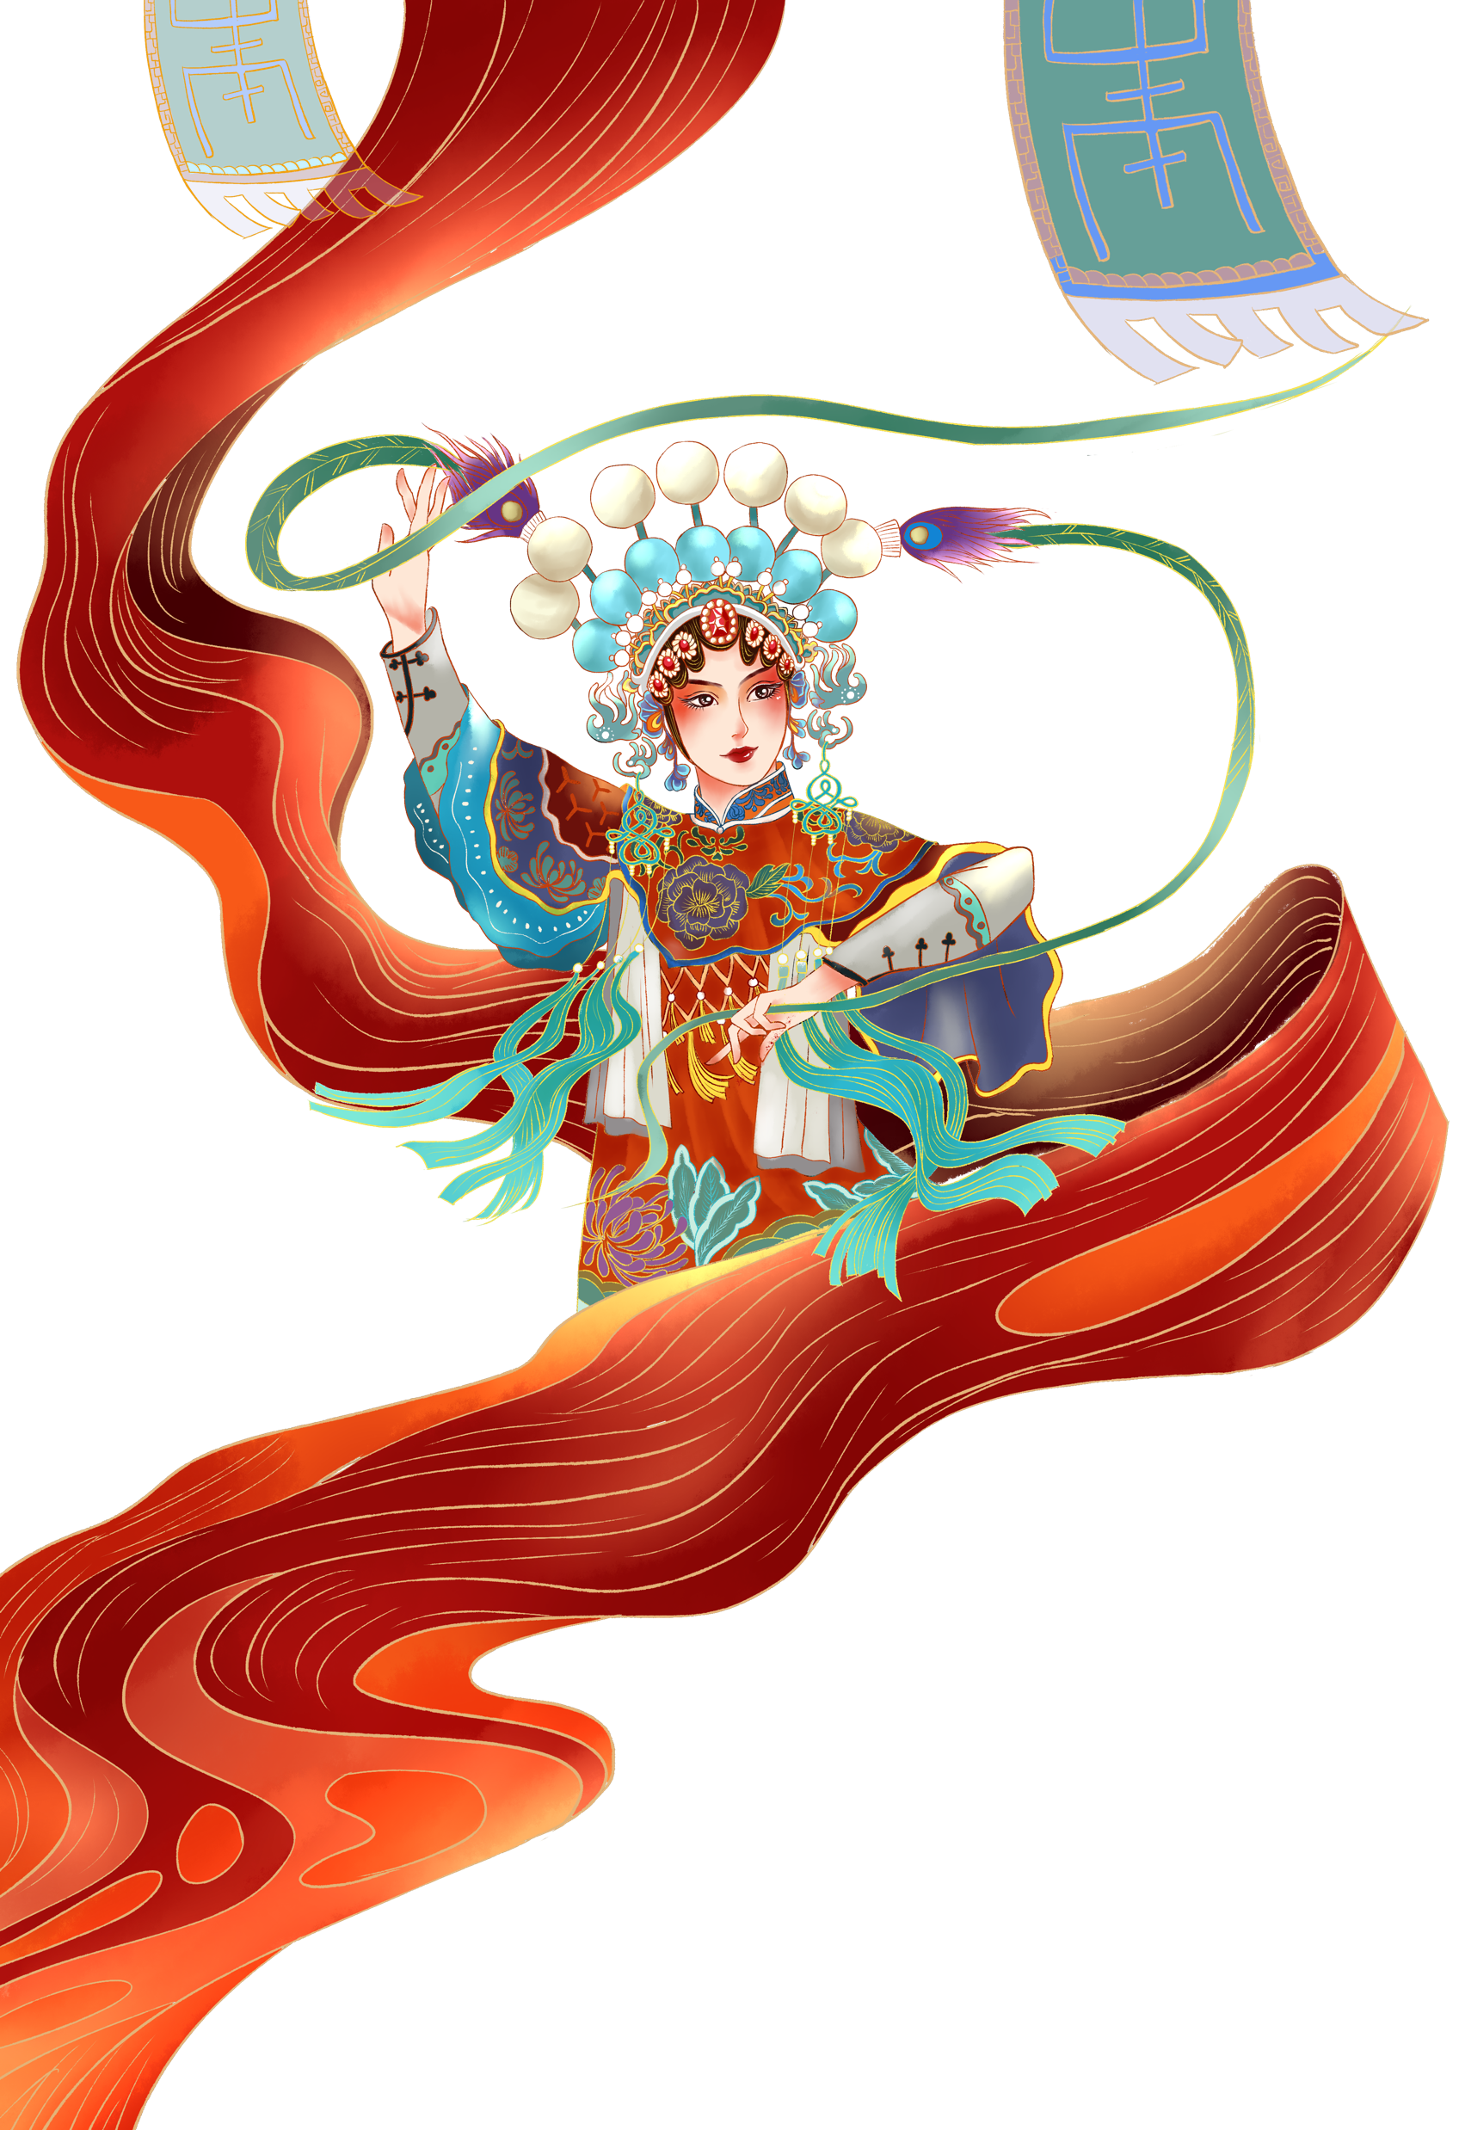
3
Motivation
Jingju music pieces can be classified according to three dimensions: “shengqiang”, “banshi” and role types
How do melodies change across these different categories? (contour, intervals, note density, length…)
Will the most salient melodic patterns match the melodic contour expected from the “shengqiang”?

Slide 10
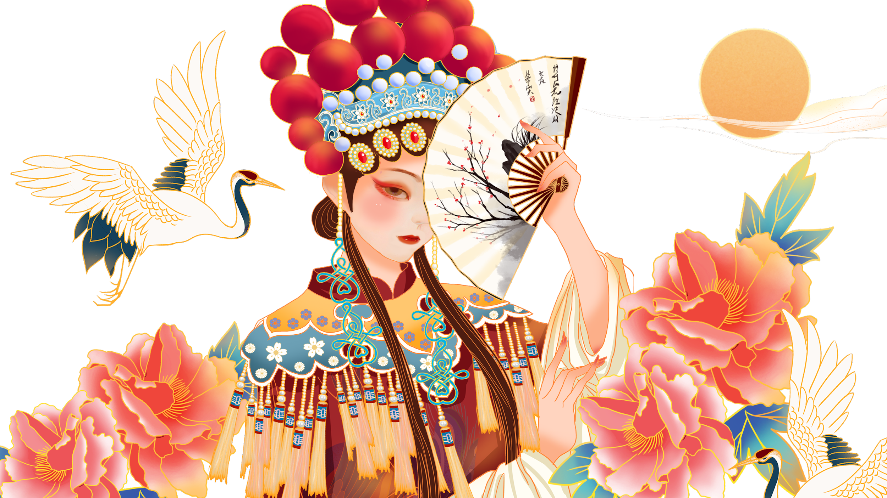
4
Methodology
Make sure that all pieces are in the same key
Develop an algorithm that can extract the most common melody of each piece
Search for matches across the dataset
Consider the classification of the pieces with matching melodies
Discuss and interpret the results

Slide 11
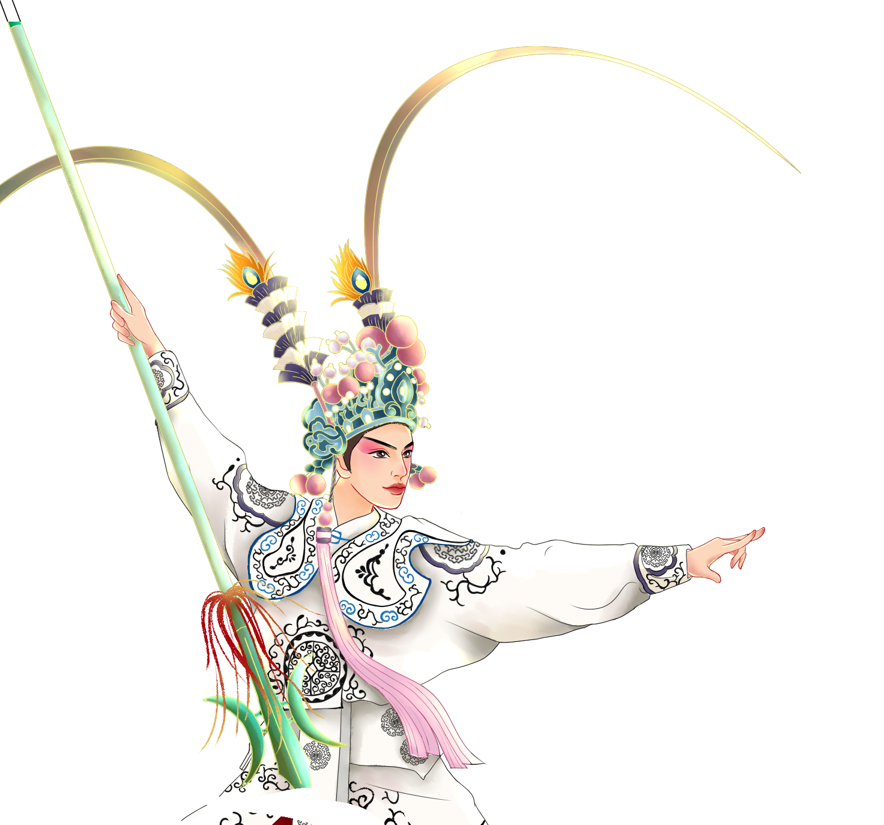
5
Expected Results
Ideally:
Pieces with matching melodies should belong to similar classification groups
The most prominent melody of each piece should follow a contour related to their “shengqiang”
Other patterns will be found with regards to role types, but not “banshi”

Slide 12
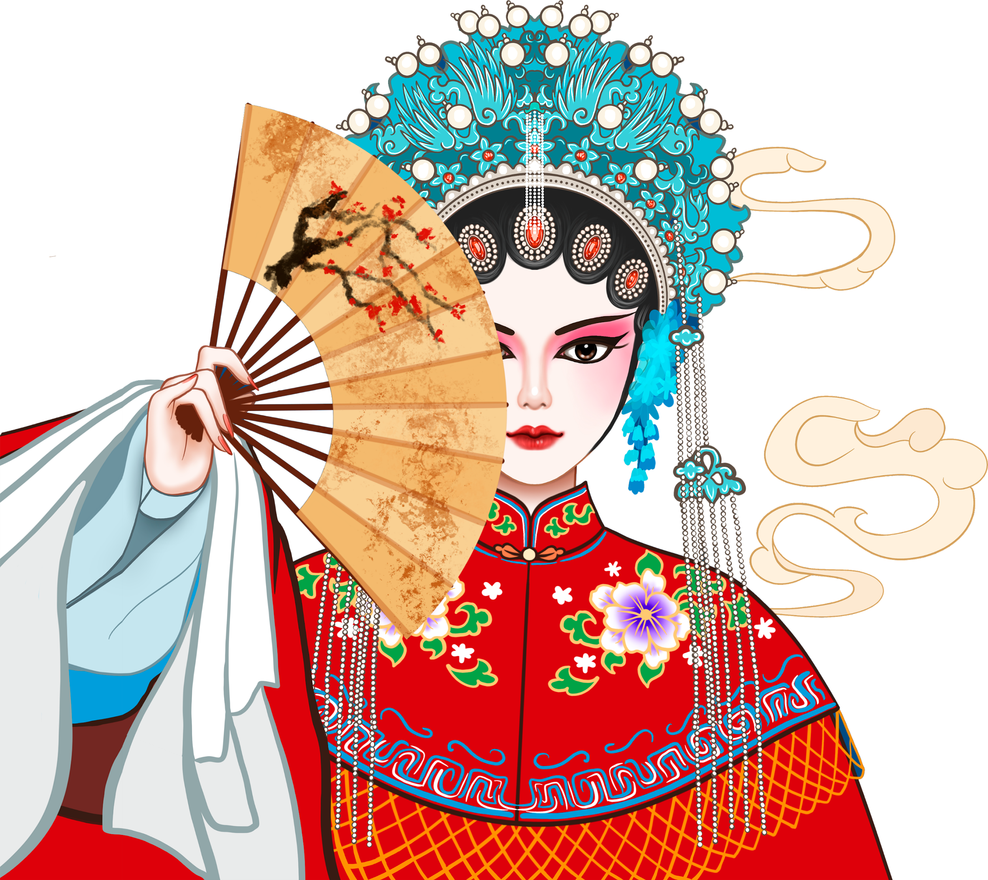
Q&A
Thanks for your listening!

